Slide 1
Benchmarking local network topology of sustainable heat supply
An open-source approach downscaling integrated assessment model results
Sebastian Zwickl-Bernhard (TUW-EEG) Daniel Huppmann (IIASA)
Young Scientist Summer Program 2021 Mid-term presentation 21/07/15

Slide 2
Motivation
We want to better understand the sustainable provision of heat service needs on the local level
Decarbonization scenarios on the global, regional or country level using integrated assessment models (IAMs)
We see that the heating sector faces fundamental changes in the sustainable energy transition
Investigate the implications of the results of IAMs on the local level focusing on centralized heat networks
Notes:
The motivation of my YSSP program is to better understand sustainable supply of heat service needs on the local level. In most cases, we study decarbonization scenarios on the global, regional or country level using integrated assessment models and see that the heating sector faces fundamental changes. The implications of these changes in the context of centralized heat networks on the local level are the focus of my project.

Slide 3
Core objective and main research question
Which downscaling technique for heat generation technologies comes closer to predicting centralized heat networks in the residential and commercial heat supply 2050 accounting for heat generation technologies‘ infrastructure needs on a high spatial granularity?
What is the gap in heat density between centralized heat networks obtained from different European decarbonization scenarios and today’s centralized heat networks?
What, if any, are the implications of such predicted centralized heat networks and corresponding heat densities in the context of benchmarking the efficiency of heat supply companies?
Notes:
So we defined essentially three core objectives for this work. First:

Slide 4
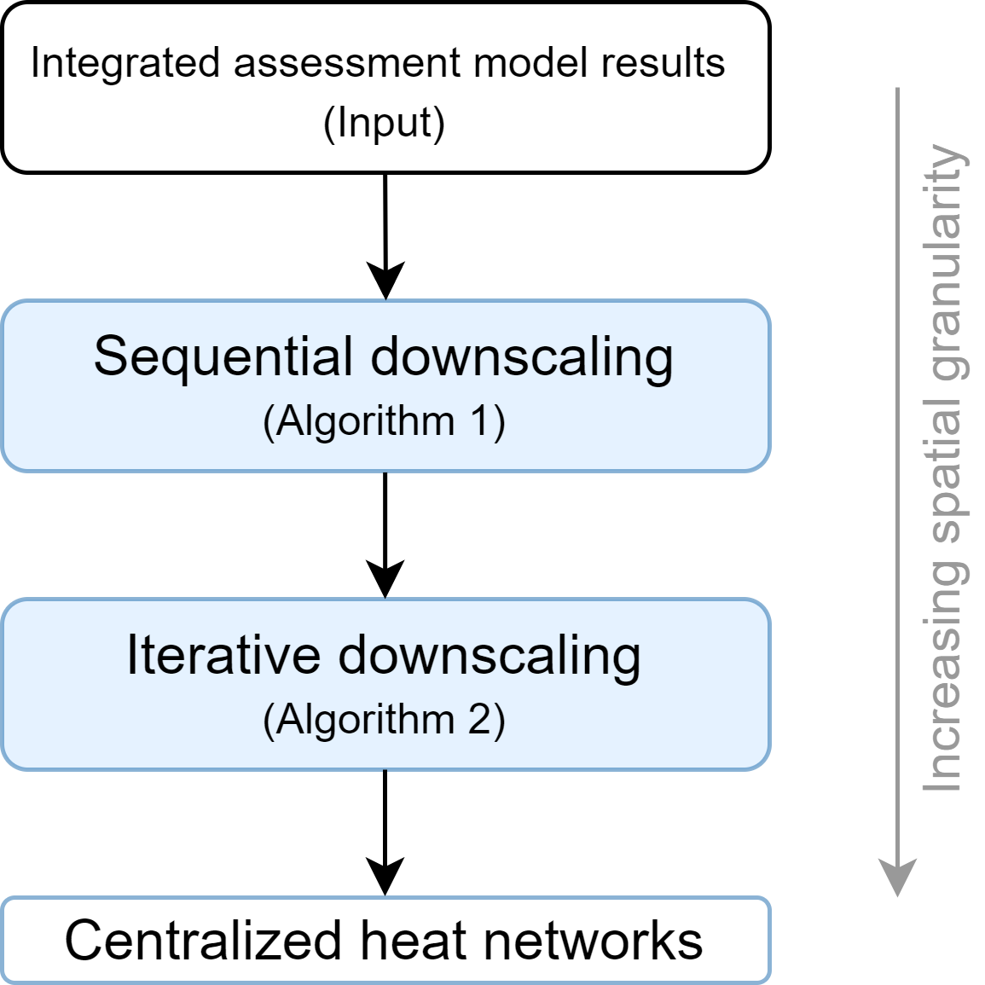
Methodology
Two downscaling algorithms on different spatial granularity levels are developed
Sequential downscaling from the country to the sub-region level (35 in Austria)
Population density as criteria
Infrastructure/network requirements of heat generation technology
Iterative downscaling from the sub-region to the small sub-region level (2095 in Austria)
Based on graph-theory
Benchmarking using tailor-made indicators
Notes:
We developed so far two different downscaling algorithms. The sequential downscaling algorithm is used to downscale integrated assessment model results from the country to 35 sub-regions in Austria using population density and infrastructure requirements of the different heat generation technologies as criteria. The iterative downscaling algorithm takes the results from Algorithm 1 and downscales to more than 2000 small sub-regions using graph-theory based benchmarking. Subsequently we obtain centralized heat networks on a high spatial granularity.

Slide 5
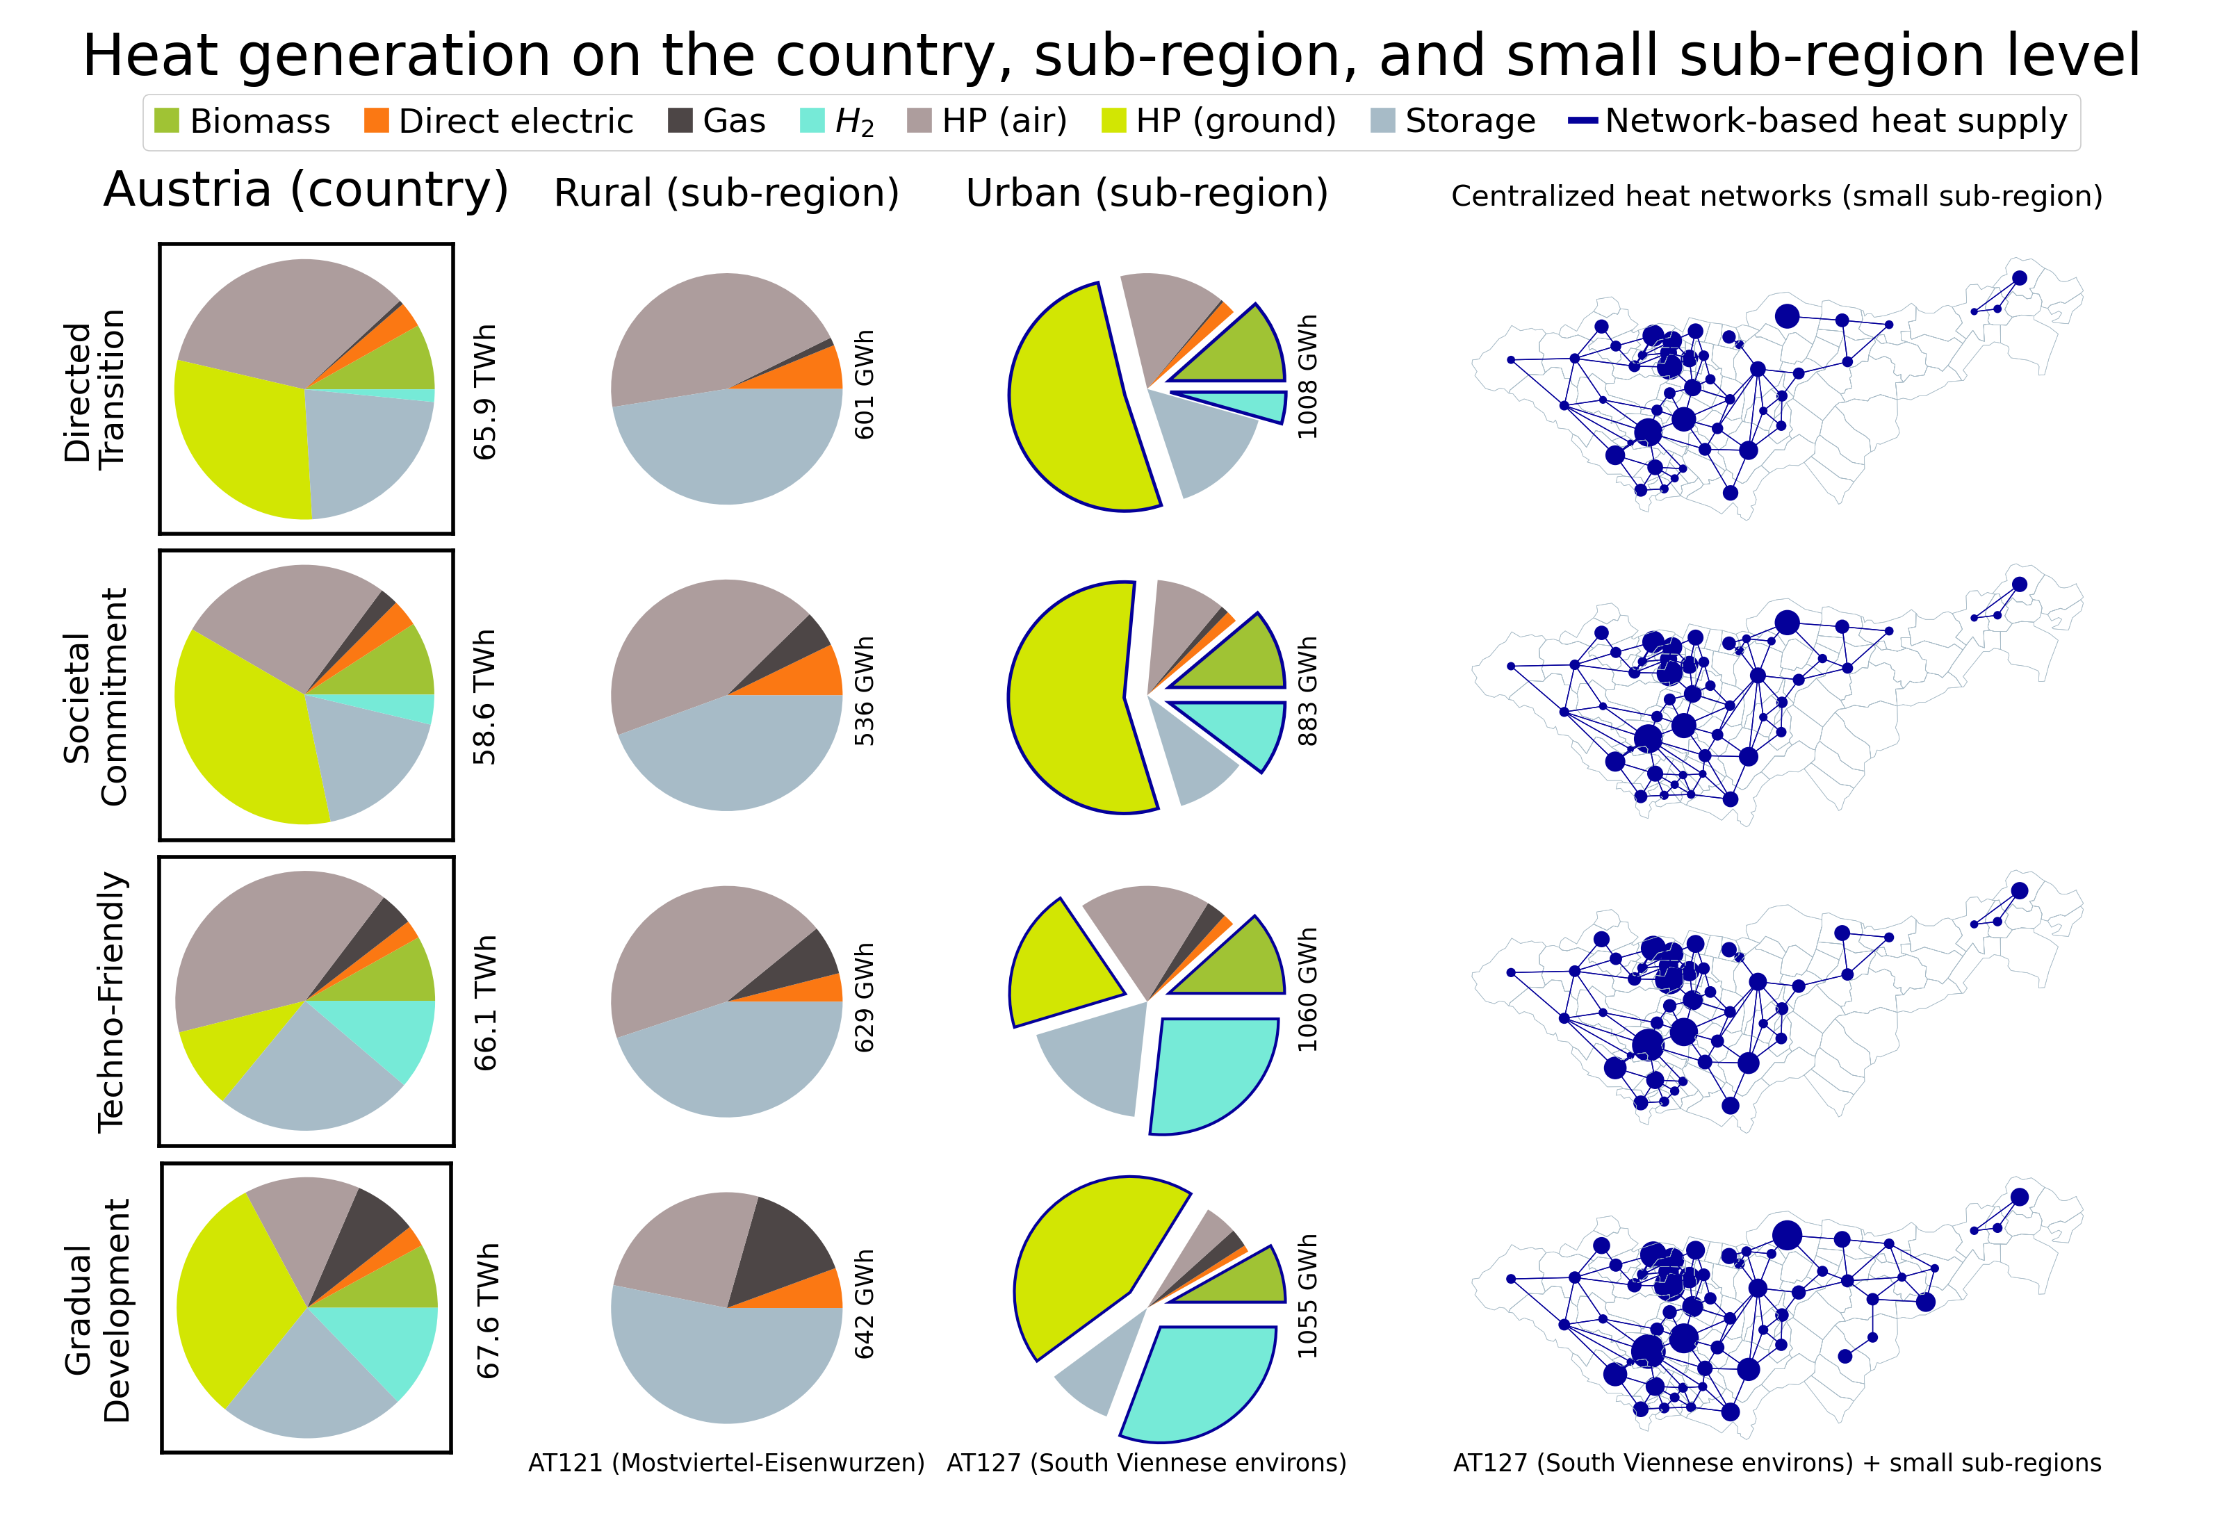
Notes:
First result slide: Here you see the heat technology generation on the country, sub-region, and small sub-region level. In the two subfigures in the middle, we highlight the difference between a rural and a urban sub-region showing that those heat generation technologies that require network infrastructure are only downscaled to densely populated areas. This is indicated by the blue edge of the generation shares for example of hydrogen in light blue.

Slide 6
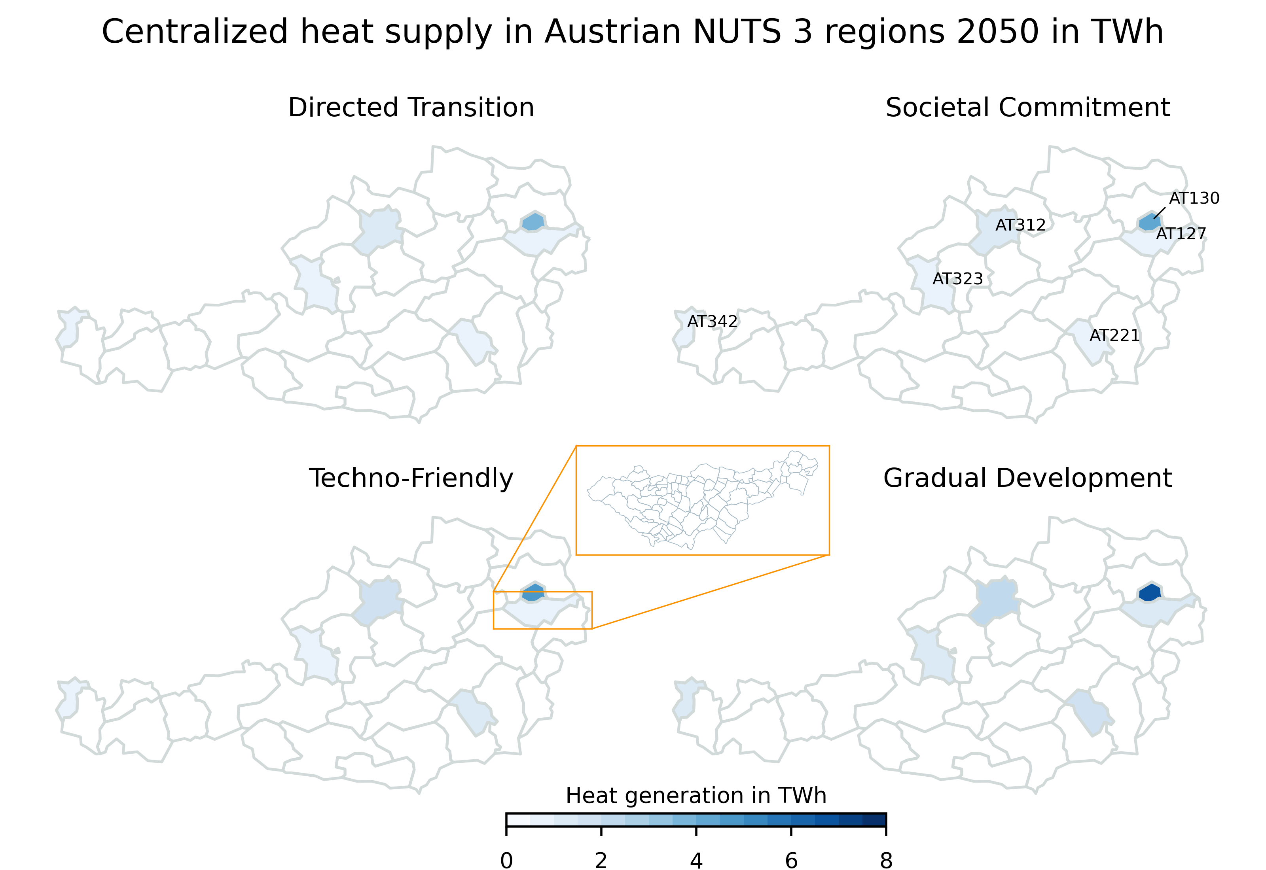
Notes:
This heatmap shows the potentials for centralized heat networks in Austria 2050. We see that we expect only six different sub-regions that provide the characteristics for heat networks. However, and this is indicated by the orange box, if we want to predict realistic heat networks on the local level, we have to increase the spatial granularity. Consequently this are the results of the sequential downscaling, and the orange box shows the input of the iterative algorithm.

Slide 7
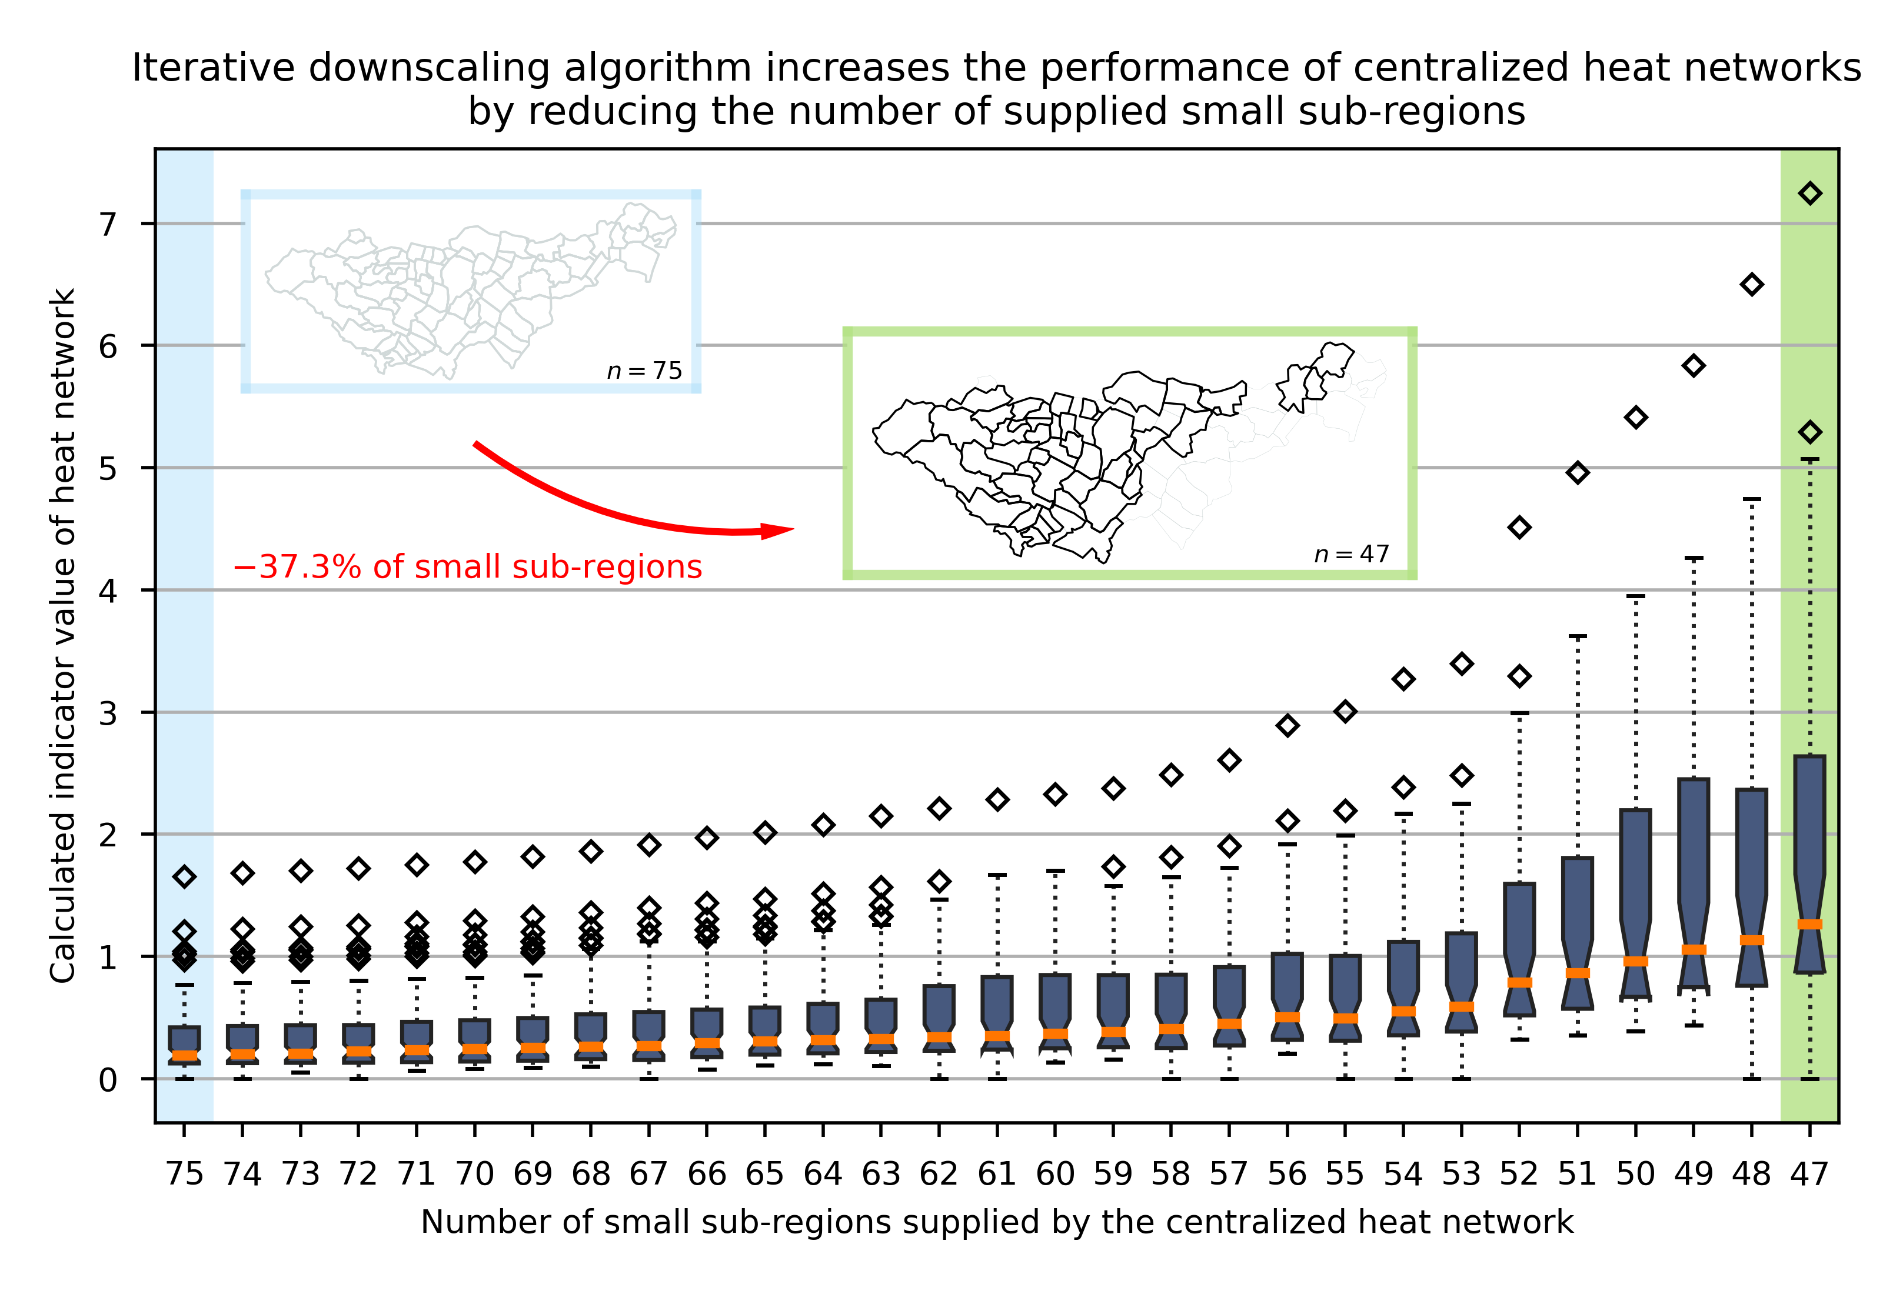
Notes:
…and this are the results of algorithm 2. The algorithm improves for those regions with potentials of centralized heat networks (in the Austrian example the six sub-regions) the network. This is done iteratively by benchmarking each small sub-region with an indicator and removing the small sub-region with the lowest indicator value. Thus the average indicator value of the remaining network improves with each iteration step and this is illustrated here.

Slide 8
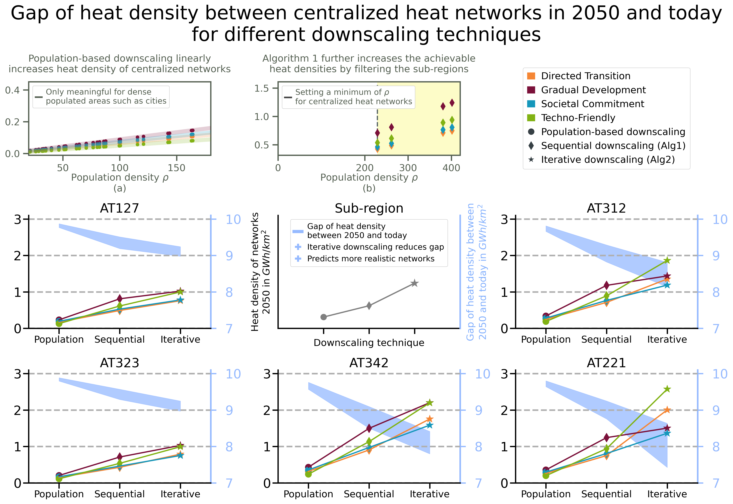
Notes:
This figure summarized the generated results by showing the heat density of centralized heat networks in 2050 (in the six subfigures at the bottom) and the gap to today’s centralized heat networks (blue). It indicates that we can significantly reduce the heat density gap by improvement of the downscaling technique. However, the gap remains significant due to the assumptions of the different decarbonization scenarios. So we conclude that this gap of heat density will have a high impact on the performance of centralized heat networks in the future and needs to be considered when benchmarking and regulating heat supply companies in the future.

Slide 9
Outlook until the final colloquium
Enhance figures of the results (more intuitive ☺)
Progress with the paper manuscript
Structure of the manuscript
Draft version of the result chapter (inclusive first iteration with supervisor)
Publish the software code as an open-source python package
Coding best practices
Documentation
Testing functions
Showcase examples, etc.

Slide 10
Thank you for your attention.
Any questions ☺
Sebastian Zwickl-Bernhard Young Scientist Summer Programm Zwickl@eeg.tuwien.ac.at https://orcid.org/0000-0002-8599-6278 https://github.com/sebastianzwickl

